Slide 1
Human Activity Recognition
INSAID Project Term 3
Gunjan Aggarwal

Slide 2
The problem
Problem Statement
Data
To recognize human activity from data collected from smartphones using accelerometer and gyroscope.
The experiments have been carried out with a group of 30 volunteers within an age bracket of 19-48 years. Each person performed six activities (WALKING, WALKING_UPSTAIRS, WALKING_DOWNSTAIRS, SITTING, STANDING, LAYING) wearing a smartphone (Samsung Galaxy S II)

Slide 3
Project Steps
Cl
Data Preprocessing
& Cleaning
Exploratory Data Analysis
Classification
Data would be analysed and profiled to clean the data.
Converting features in the format that can be used to visualize or apply machine learning algorithms.
Analyze the data to gain insights.
Visualization is the key tool here. How data is distributed, balance of data within classification labels.
Apply different classification algorithm to recognize human activity.

Slide 4
Data Preprocessing and Cleaning

Slide 5
Key Observations
For human activity classification, quality of input features has a great impact.
The common approach is to analyze signals in both time and frequency domain. This data set has both.
According to a study, body movements are constrained within frequency component of 20Hz and 99% of energy is constrained below 15Hz.
As per the description of the problem data preprocessing is done and also, feature engineering is complete. Features are also normalized between [-1, 1]

Slide 6
Cleaning
‘rn’ feature have all unique values and thus, do not anything insight. This would be removed.
There are 3609 entries
There are 562 entries columns
Data types of features are: float64(561), object(1)

Slide 7
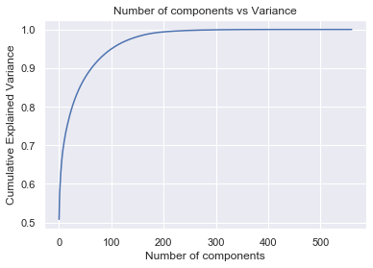
Dimensionality Reduction
Since there are 562 features, for visualization and machine learning algorithms reduction is desired.
Principal Component Analysis (PCA) Applied with cumulative variance coverage of 90%. The features were reduced to 64.

Slide 8
Dimensionality Reduction
Since 64 features are difficult to visualize, applied Manifold Algorithm called t-distributed Stochastic Neighbor Embedding. We choose t-SNE as the main purpose of t-SNE is visualization of high-dimensional data. Hence, it works best when the data will be embedded on two or three dimensions.
Features were reduced to 2. This is what was desired for us to visualize data and gain insights.

Slide 9
Exploratory Data Analysis

Slide 10
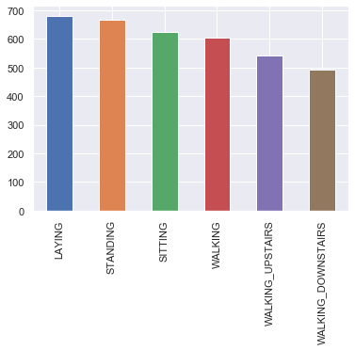
Activity Distribution
To check how labels or activity are distributed.
The labels are almost equally distributed. However, one point to note is difference in walking upstairs and downstairs. Assuming the participants had to walk the same number of stairs upwards as well as downwards
Disregarding the possibility of flawed data, the participants seem to walk roughly 10% faster downwards.

Slide 11
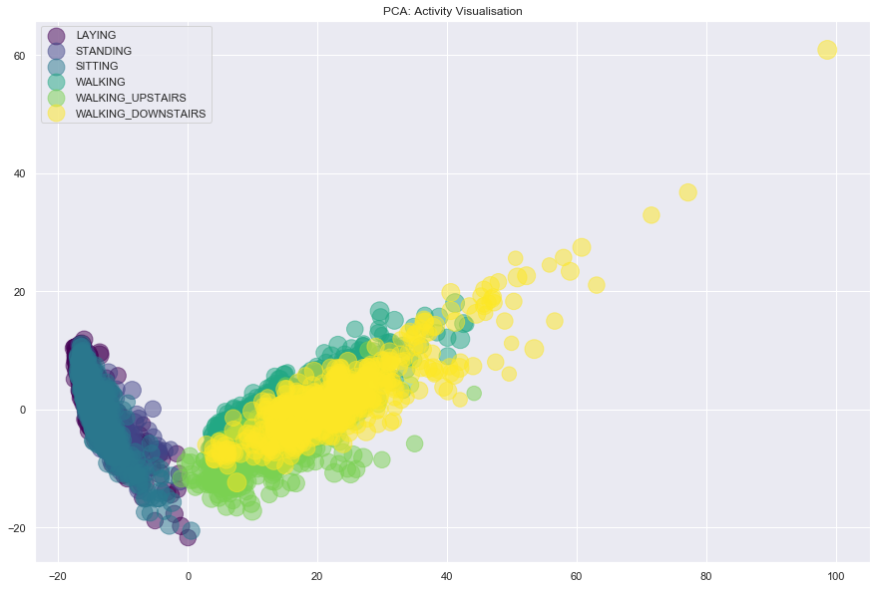
PCA Activity Separation
To see how labels or activity are separable using features present.
First we try with PCA data with 64 features from 562 features. Selecting the top two feature set.
As you can see, the activities are not separable entirely. This is because we still have 64 dimensions and PCA doesn't work very well with non-linear data. Lets' try manifold learning to reduce the dimensions further.

Slide 12
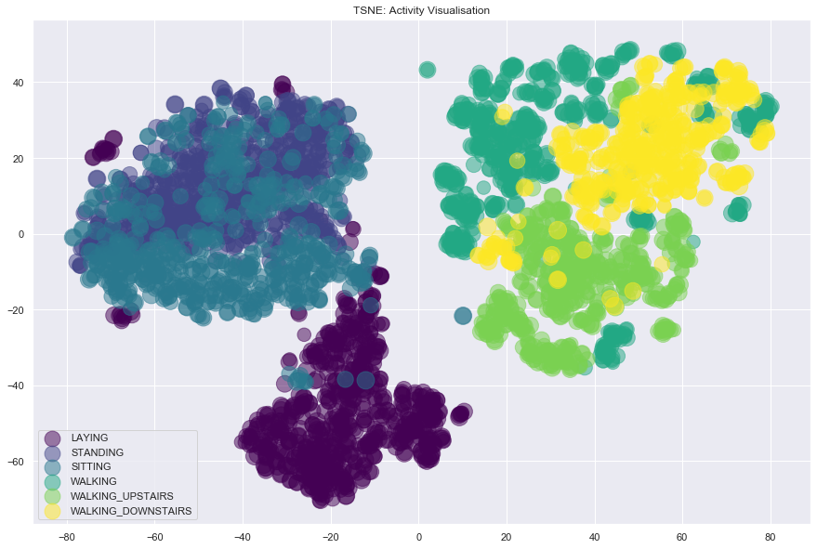
Manifold Activity Separation
After applying manifold reduction algorithm t-SNE, features were reduced to 2.
After plotting using these features, we can see now activities are easily separable.

Slide 13
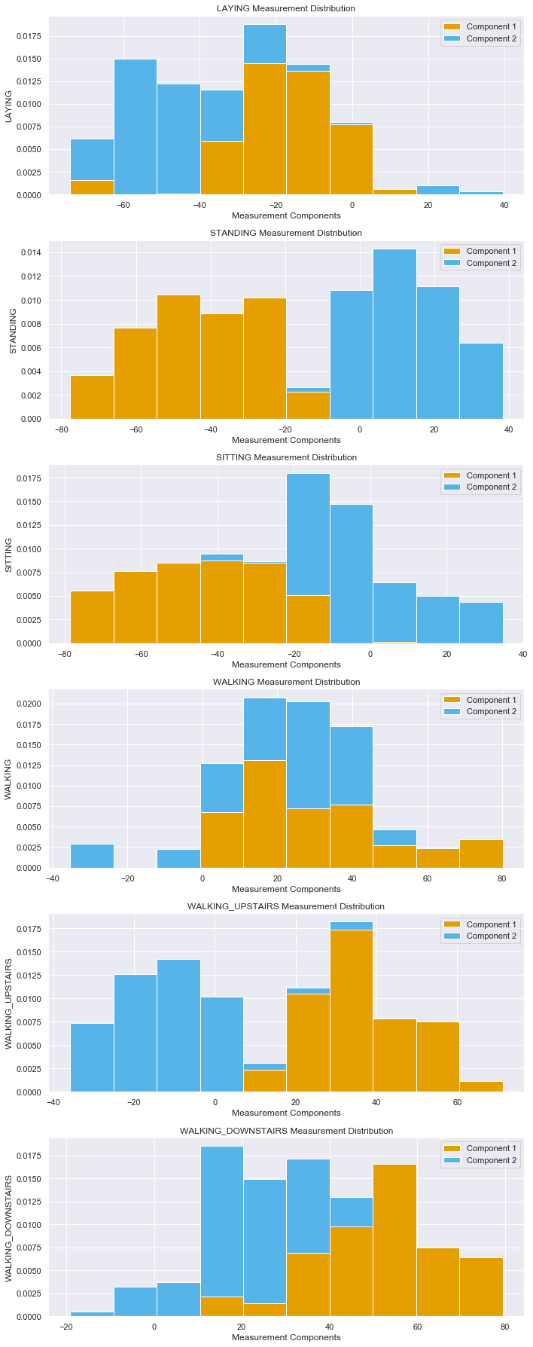
Feature Distribution Per Activity
We are interested in discriminating between activities based on activity data. Check the distribution of data between different activities.
As observed from above plots, most of the data follow the gaussian distribution.

Slide 14
Classification

Slide 15
Support Vector Machine Classifier
These are powerful and flexible class of supervised algorithms for classification. We will use Grid Search CV for hyper tuning the parameters.
# Instantiate the grid search model
grid_search = GridSearchCV(estimator=svc,
param_grid=param_grid,
scoring='accuracy',
cv=cv_sets,
verbose=1)
# Fit the grid search to the data
grid_search.fit(X_train, y_train)
best_svc = grid_search.best_estimator_
best_svc.fit(X_train, y_train)
svc_pred = best_svc.predict(X_test)

Slide 16
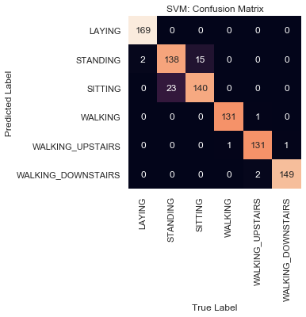
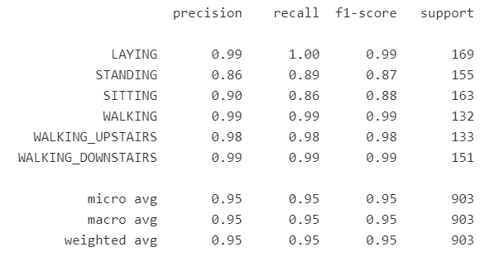
SVM Result
The test accuracy is: 95
The training accuracy is: 97

Slide 17
Logistic Regression Classifier
This is Logistic Regression algorithm for multi-class classification. It uses Softmax Function for classification. It calculates probability of a label considering the probability among all labels.
# Instantiate the grid search model
lr_grid_search = GridSearchCV(estimator=log_reg,
param_grid=param_grid,
scoring='accuracy',
cv=cv_sets,
verbose=1)
# Fit the grid search to the data
lr_grid_search.fit(X_train, y_train)
best_log_reg = lr_grid_search.best_estimator_
best_log_reg.fit(X_train, y_train)
log_reg_pred = best_log_reg.predict(X_test)

Slide 18

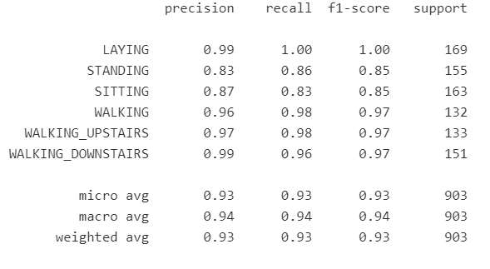
Logistic Regression Result
The test accuracy is: 93
The training accuracy is: 96

Slide 19
Conclusions

Slide 20
Conclusions
Following are the key points drawn from this project:
Dataset provided was clean and normalized. 'rn' feature has no insights. 'subject' feature was missing.
Sinces there were 562 dimensions, we need to reduce the features for better classification and visualization.
PCA is used to reduce dimensions and use the transformed features as input to classifiers.
Manifold algorithm t-SNE is used to reduce dimensions for better visualization.
Few insights were drawn from the visualization.
Applied SVM and Logistic Regression classifiers were applied on the data.
SVM turned out to be best classifier with over 95% of accuracy.

